Slide 1

APPLET

Slide 2
CS 206 OBJECTORIENTED DESIGN AND PROGRAMMING,SEM IV,PART-II
OBJECTIVES
To explain Applet Initialization and Termination.
To outline status window.
To illustrate the HTML APPLET Tag.

Slide 3
Applet Initialization and Termination
init() :-
It is the first method to be called.
Here initialization of variables are done.
Called only once during the run time of applet.
start() :-
It is called after init()
Also called to restart an applet after it has been stopped.
Called each time an applet is displayed on screen.
i.e if a user leaves a webpage and comes back the applet resumes execution at start().

Slide 4
Applet Initialization and Termination
paint() :-
Called each time an applet’s output must be redrawn.
It is called when the applet begins execution.
Or the window in which the applet is running may be overwritten by another window and then uncovered.
Or the applet window may be minimized and then restored.
It has one parameter of type Graphics.

Slide 5
Applet Initialization and Termination
stop() :-
The stop() method is called when a web browser leaves the current page containing applet-when it goes to another page.
destroy() :-
When the applet needs to be removed completely from the memory.
At that time we should free up any resources the applet may be using.
The stop() method is always called before destroy().

Slide 6
Simple Applet Display Methods
To output a string to an applet,
use drawString() which is a member of Graphics class
General form:
void drawString(String message,int x,int y)
Here message is the string to be output beginning at x,y
In a Java window, the upper left corner is 0,0

Slide 7
Simple Applet Display Methods
To get the foregroundcolor,
Use getForeground() which is a member of Component
General form:
Color getForeground()
To get the backgroundcolor,
Use getBackground() which is a member of Component
General form:
Color getBackground()

Slide 8
A simple applet that sets the foreground and background colors and outputs a string
import java.awt.*;
import java.applet.*;
/*
<applet code="Sample" width=300 height=50>
</applet>
*/
public class Sample extends Applet{
String msg;
// set the foreground and background colors.
public void init() {
setBackground(Color.cyan);
setForeground(Color.red);
msg = "Inside init( ) --";
}

Slide 9
A simple applet that sets the foreground and background colors and outputs a string
// Initialize the string to be displayed.
public void start() {
msg += " Inside start( ) --";
}
// Display msg in applet window.
public void paint(Graphics g) {
msg += " Inside paint( ).";
g.drawString(msg, 10, 30);
}
}

Slide 10
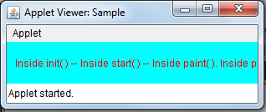

Slide 11
Requesting Repainting
Repainting
Whenever the applet needs to update the information displayed in its window, it simply calls repaint()
It causes the system to execute a call to the applet’s update() method
The update() method in its default implementation calls paint()
Simplest form of repaint():-
void repaint()
This causes the entire window to be repainted

Slide 12
STATUS WINDOW
In addition to displaying information in its window, an applet can also output a message to the status window of the browser or applet viewer on which it is running.
To do so, call showStatus( ) with the string that you want displayed.
Pass the string to be displayed as the argument.

Slide 13
STATUS WINDOW
import java.applet.*;
import java.awt.*;
/*
<applet code="Status" width=300 height=300>
</applet>
*/
public class Status extends Applet
{
public void init()
{
setBackground(Color.cyan);
}

Slide 14
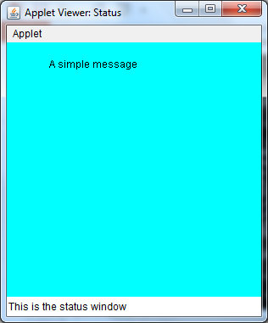
public void paint(Graphics g)
{
g.drawString("A simple message",50,30);
showStatus("This is the status window");
}
}

Slide 15
The HTML APPLET Tag
< APPLET
[CODEBASE = codebaseURL]
CODE = appletFile
[ALT = alternateText]
[NAME = appletInstanceName]
WIDTH = pixels HEIGHT = pixels
[ALIGN = alignment]
[VSPACE = pixels] [HSPACE = pixels]
>
[< PARAM NAME = AttributeName VALUE = AttributeValue>]
[< PARAM NAME = AttributeName2 VALUE = AttributeValue>]
. . .
[HTML Displayed in the absence of Java]
</APPLET>

Slide 16
The HTML APPLET Tag
CODEBASE: CODEBASE is an optional attribute that specifies the base URL of the applet code, which is the directory that will be searched for the applet’s executable class file (specified by the CODE tag). The HTML document’s URL directory is used as the CODEBASE if this attribute is not specified.
CODE :CODE is a required attribute that gives the name of the file containing your applet’s compiled .class file
ALT :The ALT tag is an optional attribute used to specify a short text message that should be displayed if the browser recognizes the APPLET tag but can’t currently run Java applets.
NAME :NAME is an optional attribute used to specify a name for the applet instance. Applets must be named in order for other applets on the same page to find them by name and communicate with them.

Slide 17
The HTML APPLET Tag
WIDTH and HEIGHT :are required attributes that give the size (in pixels) of the applet display area.
ALIGN :is an optional attribute that specifies the alignment of the applet. This attribute is treated the same as the HTML IMG tag with these possible values: LEFT, RIGHT, TOP, BOTTOM, MIDDLE, BASELINE, TEXTTOP, ABSMIDDLE, and ABSBOTTOM.
VSPACE and HSPACE:. VSPACE specifies the space, in pixels, above and below the applet. HSPACE specifies the space, in pixels, on each side of the applet.
PARAM NAME and VALUE :The PARAM tag allows you to specify applet-specific arguments in an HTML page. Applets access their attributes with the getParameter( ) method.

Slide 18
PASSING PARAMETERS TO APPLETS
The APPLET tag in HTML allows you to pass parameters to the applet.
To retieve a parameter, use the getParameter() method.
It returns the specified parameter in the form of a String object.
General form for parameter passing:-
<APPLET CODE=appletFile WIDTH=pixels HEIGHT=pixels>
<PARAM NAME=Attributename VALUE=Attributevalue>
<PARAM NAME=Attributename VALUE=Attributevalue>
.....
</APPLET>

Slide 19
import java.awt.*;
import java.applet.*;
public class ParamBanner extends Applet implements Runnable
{
String msg;
Thread t;
int state;
boolean stopFlag;
public void init()
{
setBackground(Color.cyan);
setForeground(Color.red);
}

Slide 20
public void start()
{
msg=getParameter("message");
if(msg==null) msg="Message not found";
t=new Thread(this);
stopFlag=false;
t.start();
}
public void run()
{
char ch;

Slide 21
public void stop()
{
stopFlag=true;
t=null;
}
public void paint(Graphics g)
{
g.drawString(msg,50,30);
}
}
for(;;)
{
try
{
repaint();
Thread.sleep(250);
ch=msg.charAt(0);
msg=msg.substring(1,msg.length());
msg+=ch;
if(stopFlag) break;
}
catch(InterruptedException e)
{
}
} }

Slide 22
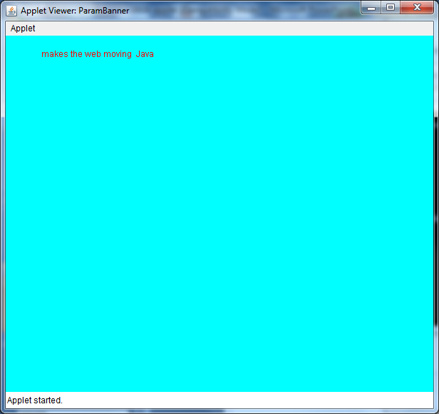
PASSING PARAMETERS TO APPLETS
<applet code="ParamBanner" width=600 height=500>
<param name=message value="Java makes the web moving ">
</applet>

Slide 23
Write a GUI based Java program to check whether a given number is prime or not. Use appropriate AWT components and event handling.
import java.awt.*;
import java.awt.event.*;
import java.applet.*;
/*
<applet code="Appletprime" width=300 height=50>
</applet>
*/
public class Appletprime extends Applet implements ActionListener {
Button a;
TextField t;
String msg="";
public void init() {

Slide 24
a=new Button("check");
t=new TextField(10);
add(t);
add(a);
a.addActionListener(this);
t.addActionListener(this);
}
public void actionPerformed(ActionEvent ae)
{
int n=Integer.parseInt(t.getText());
int i=2,done=0;
while (i<n)
{
if(n%i==0)
done=1;
i=i+1;
}

Slide 25
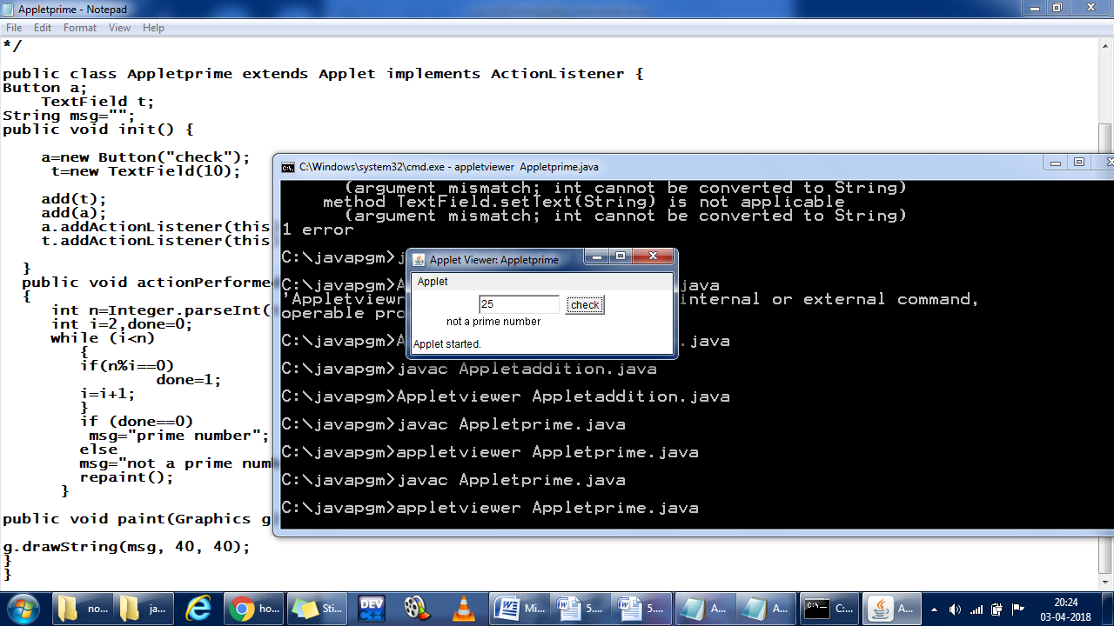
if (done==0)
msg="prime number";
else
msg="not a prime number";
repaint();
}
public void paint(Graphics g) {
g.drawString(msg, 40, 40);
}

Slide 26
CONCLUSION
Familiarized Applet initialization and termination.
To display message in status window use show status method.
To pass parameters to applet program make use of PARAM attribute of HTML tag.

